Slide 1
Fisher Information and Applications
MLCV Reading Group
3Mar16

Slide 2
Motivation
Connections to statistics, information theory, and differential geometry
Broad interests from different research communities, and many potential applications. E.g. machine learning, computer vision, neuroscience, economics
Below: A few image-based shape applications

Slide 3
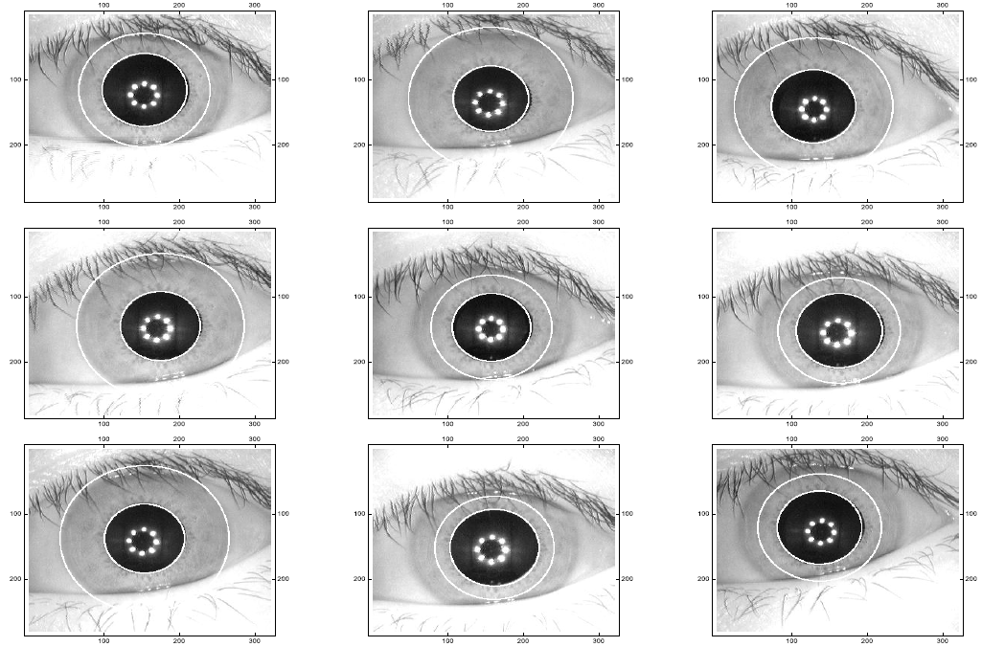
Detect Circles in Iris Images
A Fisher–Rao Metric for Curves Using the Information in Edges, SJ Maybank, Journal of Mathematical Imaging and Vision, 2015
Notes:
Fig. 6 Circles detected by Algorithm 2 in the first nine images of the CASIA Iris Interval database.
A Fisher–Rao Metric for Curves Using the Information in Edges, by SJ Maybank, Journal of Mathematical Imaging and Vision, 2015

Slide 4
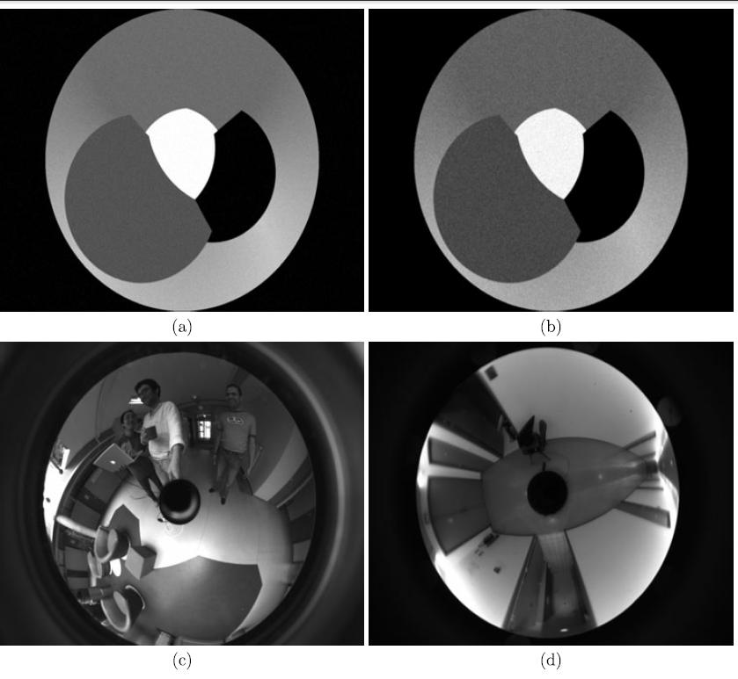
Detect Lines in Paracatadioptric Images
A Fisher-Rao Metric for Paracatadioptric Images of Lines, Maybank, Ieng, Benosman, IJCV, 2012
Notes:
The original images:
Synthetic1; (b) Synthetic2; (c) Office2; (d) Corridor

Slide 5
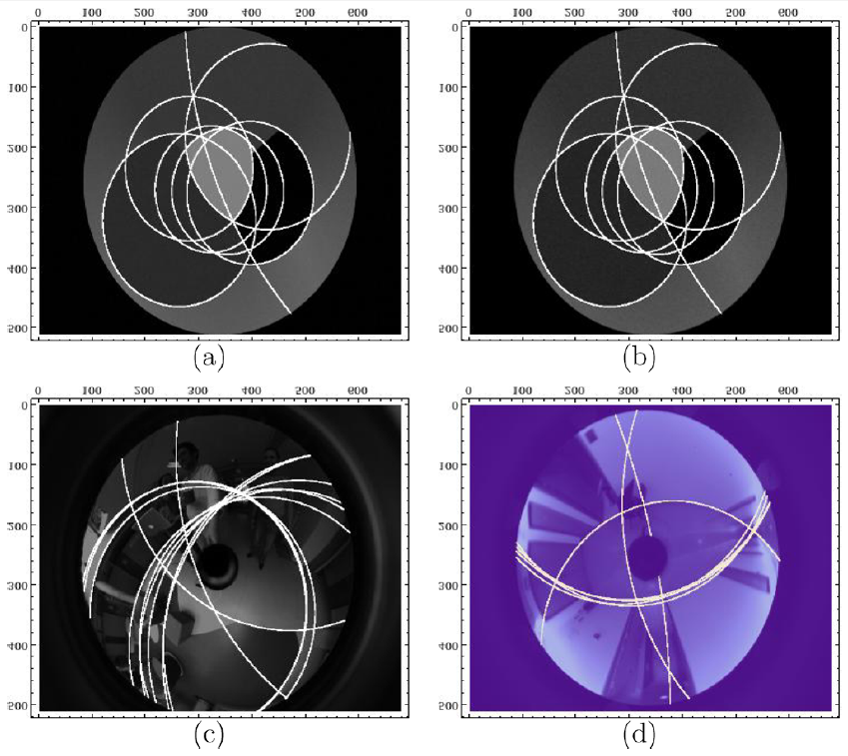
Detect Lines in Paracatadioptric Images
A Fisher-Rao Metric for Paracatadioptric Images of Lines, Maybank, Ieng, Benosman, IJCV, 2012
Notes:
The original images:
Synthetic1; (b) Synthetic2; (c) Office2; (d) Corridor

Slide 6
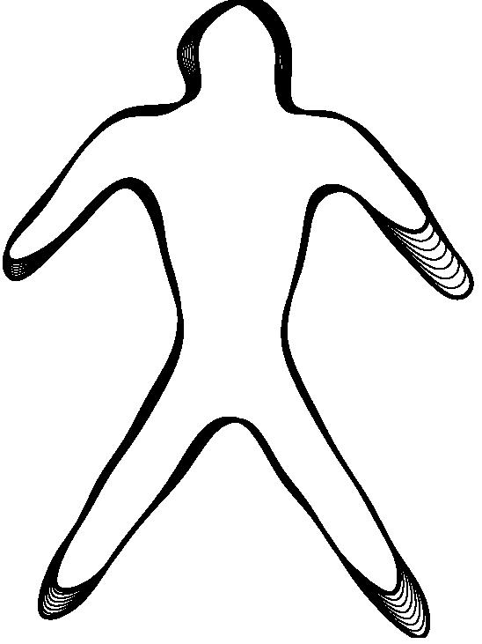
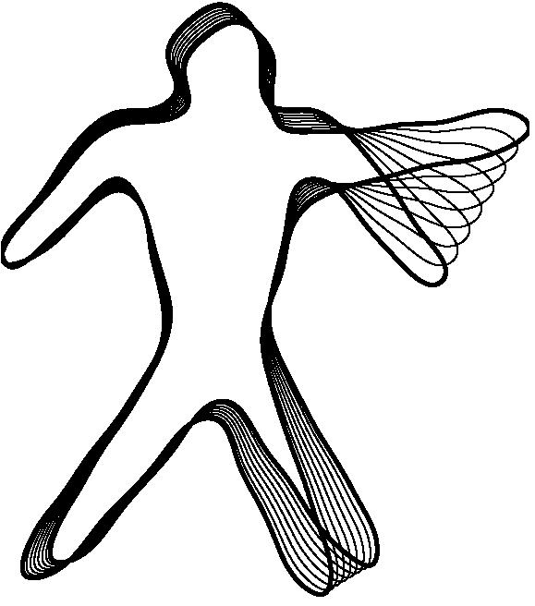
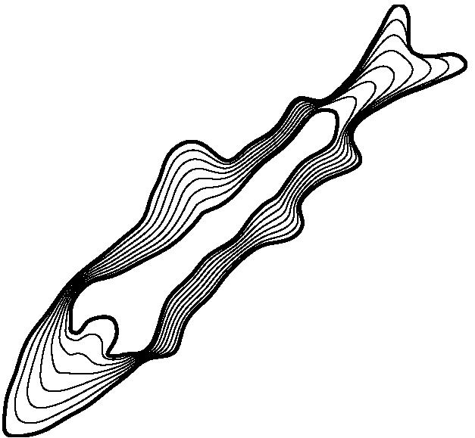
Shape Analysis
M. Bauer, M. Bruveris, P. W. Michor. Uniqueness of the Fisher-Rao metric on the space of smooth densities, 2014. arXiv:1411.5577
And many many other applications ….
Copy from http://www.brunel.ac.uk/~mastmmb/images/h2geodesic1.jpg
Notes:
http://www.brunel.ac.uk/~mastmmb/images/h2geodesic1.jpg

Slide 7
Our Focus
Basics of Fisher information
Connection to MLE
Cramer-Rao bound
Connection to KL divergence, mutual information
Connection to differential geometry
Applications? Papers in NIPS, IJCV, ….
Warning: a bit intensive in equations

Slide 8
Fisher Information
A parametric family of distributions with each one indexed by the particular parameter
Denote the log-likelihood
Denote the 1st-order derivative for 1D, and in general,
The Fisher information associated with is

Slide 9
Fisher Information
-- Single parameter scenario
Fisher information is the variance of the score
, as
It can be interpreted as the curvature of the log-likelihood function
Theorem (Cramer-Rao bound): the variance of any estimator from iid random sample of size n of underlying distribution , is bounded by

Slide 10
Fisher Information
-- Single parameter scenario
Remark:
When low curvature (almost flat log-likelihood curve), expect large deviation from
When high curvature (peaky log-likelihood), expect small deviation from
Example, consider Poisson distribution
We have , thus

Slide 11
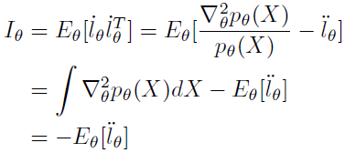
Fisher Information
-- Multi-parameter scenario
Remarks:
Score function has zero mean under , i.e.
Also,
We have

Slide 12
Fisher Information
-- Multi-parameter scenario
Theorem (Multi-param. Cramer-Rao bound): The variance of any vector-valued estimator from iid random sample of size n of underlying distribution , is bounded by
Example (Exponential family of distributions): Since , we have
and . Then

Slide 13
Our Focus
Basics of Fisher information
Connection to MLE
Cramer-Rao bound
Connections to KL divergence, mutual information
Connection to differential geometry
Applications? Papers in NIPS, IJCV, ….

Slide 14
KL-divergence
Entropy
Relative entropy (i.e. KL-divergence)
Remark:
KL(p||q) >=0

Slide 15
KL-divergence of Exponential Family
Recall
We have
KL is roughly quadratic for exp. family distributions, where quadratic form is given by the Fisher information matrix

Slide 16
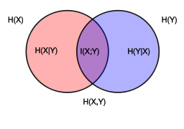
Mutual Information
By definition
Remark:
We have
I(x,y) -> 0, when p(x,y)-> p(x) p(y)
I(x,y)-> max, when p(x,y) is farther away from p(x) p(y)
Fisher information provides a 2nd-order approximation of MI

Slide 17
Our Focus
Basics of Fisher information
Connection to MLE
Cramer-Rao bound
Connections to KL divergence, mutual information
Connection to differential geometry
Applications? Papers in NIPS, IJCV, ….

Slide 18
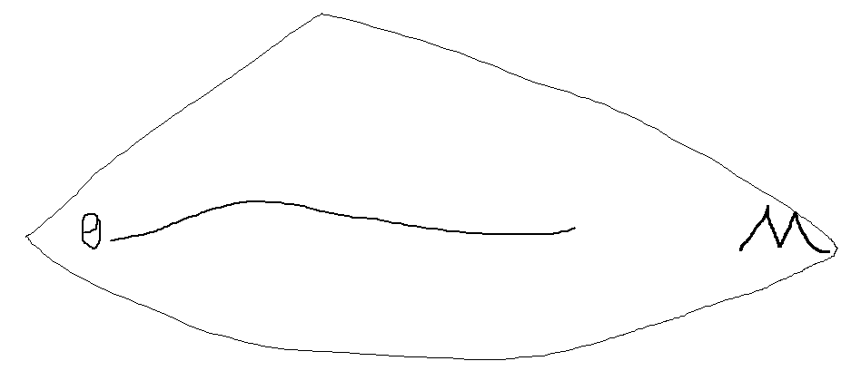
Fisher Information Metric
-- 101 of diff. geometry
A statistical manifold
Two coordinate systems: with
Remarks:
since

Slide 19
Fisher Information Metric
Remarks:
is p.d. matrix of size mxm
We also have
For exponential family: It is the Hessian of A
is the Jacobian matrix , since

Slide 20
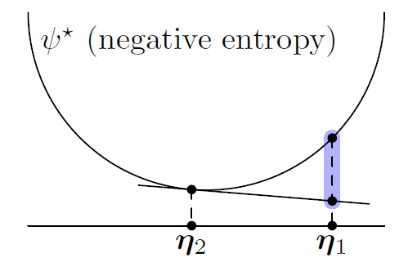
Fisher Information Metric
-- Information Divergence
Consider Bregman divergence:
By Taylor expansion of
This explains why learning is m-projection (i.e. the 2nd argument of KL)
It can be shown KL is the only valid Bregman divergence here.

Slide 21
Our Focus
Basics of Fisher information
Connection to MLE
Cramer-Rao bound
Connections to KL divergence, mutual information
Connection to differential geometry
Applications? Papers in NIPS, IJCV, ….

Slide 22
Applications (a very partial list)
Optimal Neural Population Codes for High-dimensional Stimulus Variables, by Z. Wang, A. Stocker and D. Lee., NIPS'13
A Fisher–Rao Metric for Curves Using the Information in Edges, by SJ Maybank, Journal of Mathematical Imaging and Vision, 2015
A Fisher-Rao Metric for Paracatadioptric Images of Lines, by SJ Maybank, S Ieng, R Benosman, IJCV'12
Information geometry and minimum description length networks, Ke et al., ICML'15
Space-time local embeddings, Ke et al., NIPS'15
An Information Geometry of Statistical Manifold Learning, Ke et al., ICML'14
Scaling Up Natural Gradient by Sparsely Factorizing the Inverse Fisher Matrix, Grosse & Salakhutdinov, ICML’15

