Slide 1
Recent Advances in Video based Action Recognition
Bingbing Ni
Advanced Digital Sciences Center, Singapore
1

Slide 2
What is action recognition?
Given an input video/image, perform some appropriate processing, and output the “action label”
“action”
“activity”
“event”
level of semantics
“walking, pointing,
putting
etc.”
“talking on the phone, drinking tea
etc.”
“a soccer game, a birthday party etc.”
2

Slide 3
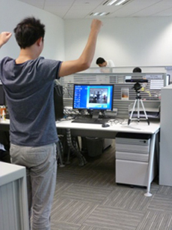
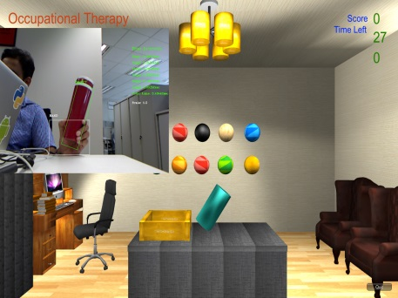
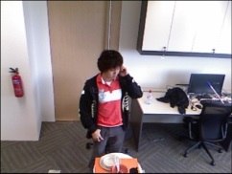
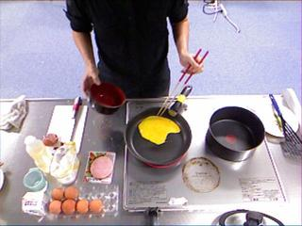
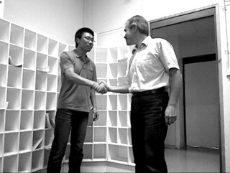
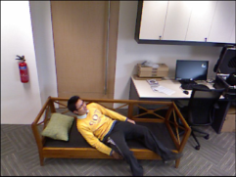
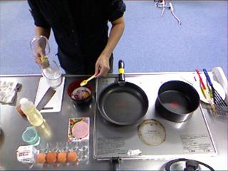
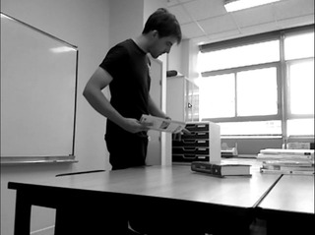
Example Applications
Automatic Tele-Rehabilitation
Fine-grained action recognition
Interactive action recognition
Daily activity recognition
3
Intelligent Assisted Living and Home Monitoring

Slide 4
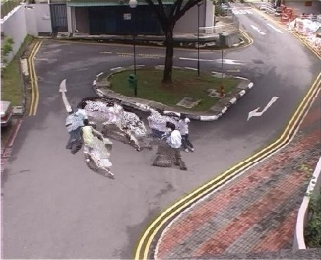
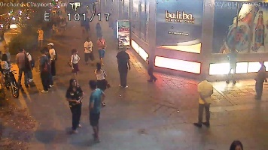
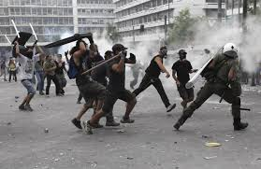
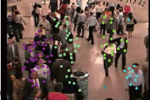
Example Applications
Fighting
loitering
Riot
Crowd congestion
Crowd Behavior/Event Analysis
4

Slide 5
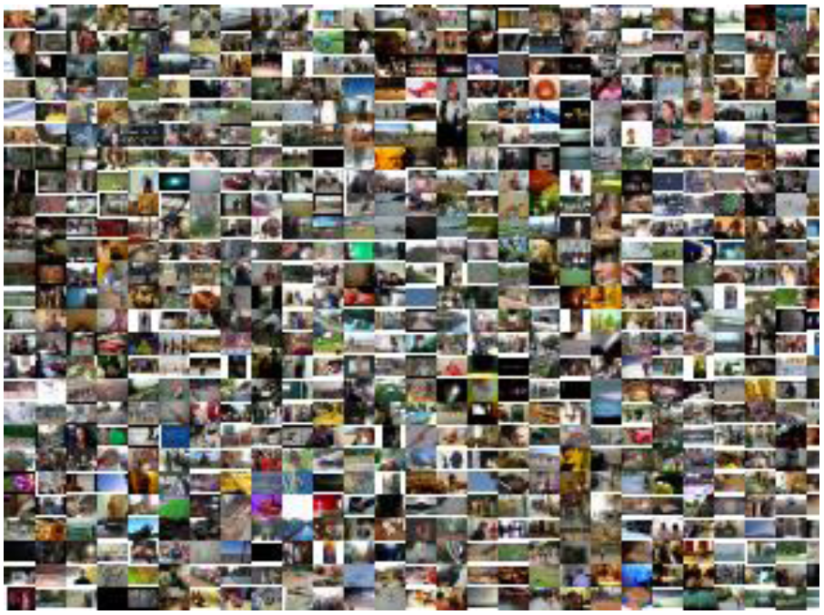
Example Applications
Unconstrained video search and retrieval
5

Slide 6
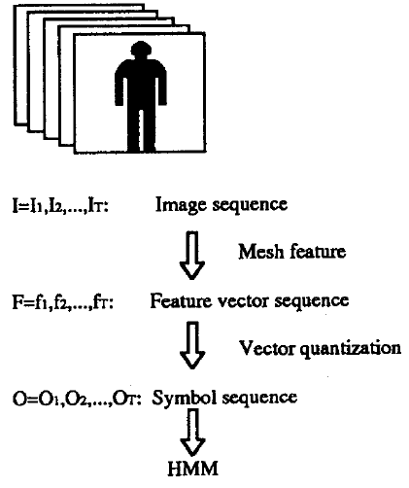
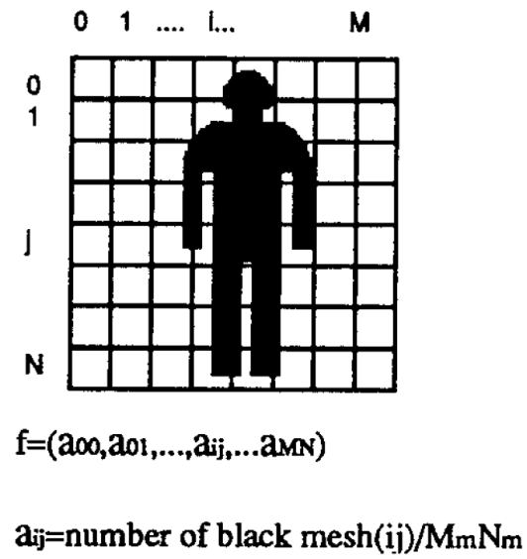
An Early Action Recognition Pipeline
original background foreground
silhouette feature
6
[Yamato et al. 1992]

Slide 7
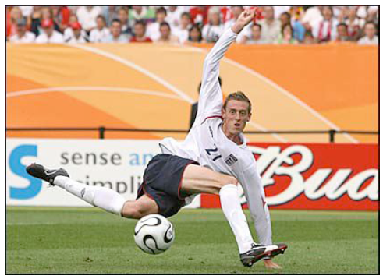
Why Action Recognition Is Challenging?
Intra‐class variation
Non-rigid motion
Human appearance variation
View-point change
Object/human pose variation
Background clutter
Occlusion
Lighting
etc.
7

Slide 8
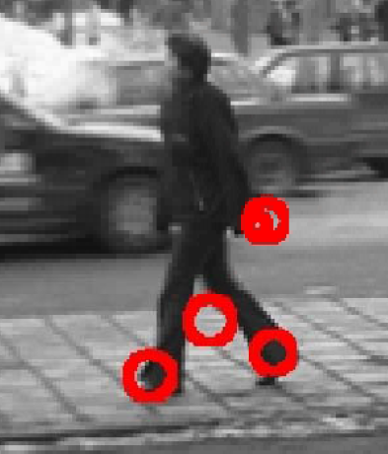
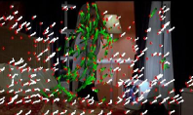
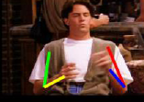
Design good features for action representation
Example features
“space-time interest points”
“dense trajectories”
“body joints”
“motion history images”
8

Slide 9
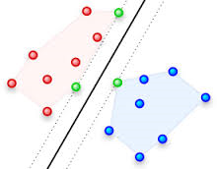
Design good classifiers
Example: Support Vector Machine (SVM) classifier
positive samples “walking”
w: separating hyper-plane
action representation vector x
action representation vector x
negative samples “not walking”
action representation vector x
Linear SVM: y = w^{T}x + b
y>0 : “walking”
y<0 : “not walking”
9

Slide 10
Outline
PART I RGB based Action Recognition
Features for Action Representation
Shape and Pose
Motion
Action Recognition Framework
“Parts” + “Matching”
“Pooling” + “Classifier”
Mid-level Approaches
PART II RGB-Depth based Action Recognition
Introduction to Depth Sensor (Kinect)
RGB-Depth Features
RGB-Depth Context
Conclusions and More
10

Slide 11
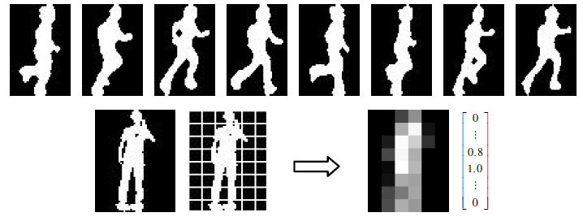
Shape Feature – Silhouette
extract silhouette by background subtraction
block-based representation
Factorial CRF for recognition
[Wang and Suter 2007]
11

Slide 12
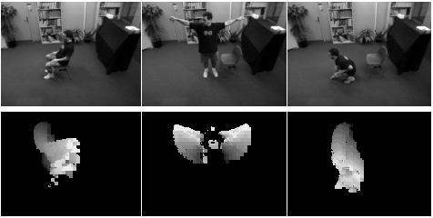
Shape Feature – Motion History Images
Action can be characterized by “changing of shape”
In an MHI, pixel intensity is a function of the motion history at that location, where brighter values correspond to more recent motion
Use Hu moments for action representation
[Bobick and Davis 2001]
12

Slide 13
Shape Feature – Human Key Pose
annotated positive samples for “legs open” pose
HoG-SVM detector training
testing video frame
SVM coefficients
sliding window correlation
correlation
negative samples
red: high value
blue: low value
response map
“detection”
“training”
13
[Raptis and Sigal 2013]

Slide 14
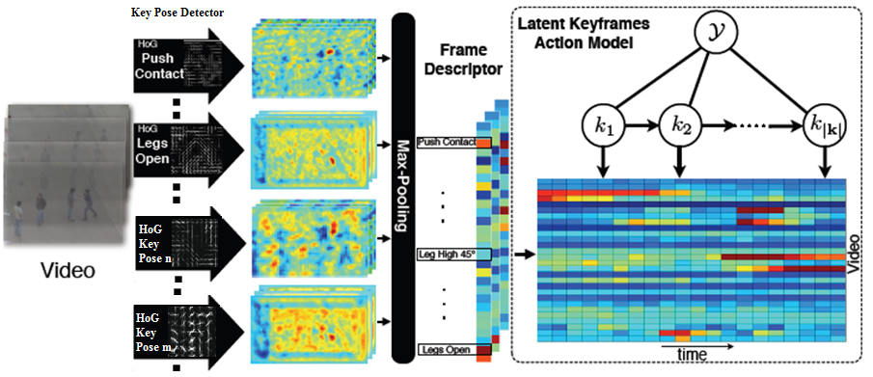
Shape Feature – Human Key Pose (Cont’d)
Run pose detectors (HoG Poselet [Bourdev and Malik 2009]) over all video frames
Models actions as a sparse sequence of spatio-temporally localized key-frames
14
[Raptis and Sigal 2013]

Slide 15
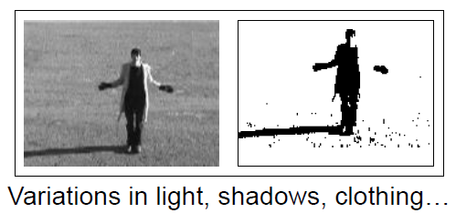
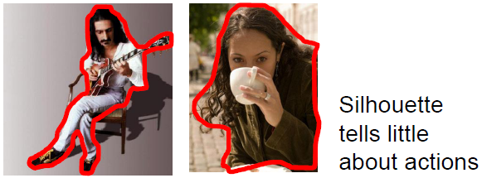
Shape Features for Action Recognition
Pros
Simple
Fast to compute
Cons
Prune to background subtraction errors
Cannot model interior structure and local motion
15
[Picture by Laptev]

Slide 16
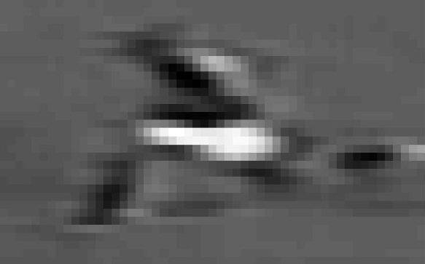
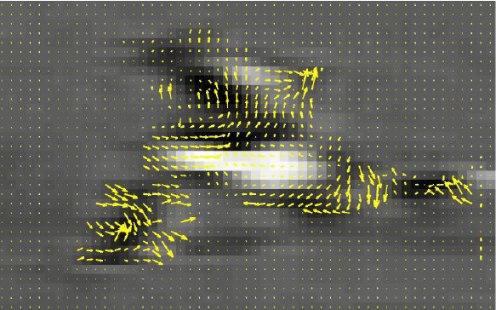
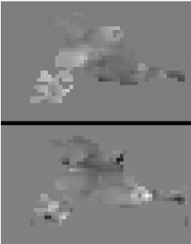
Motion Feature – Optic Flow
original image
optic flow
half-wave rectification of each component
blur with a Gaussian kernel
x and y component of optic flow
16
[Efros et al. 2003]

Slide 17
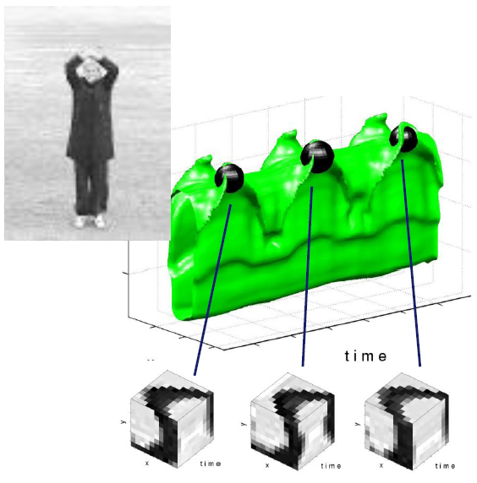
Motion Feature – Space Time Interest Point
Detection
Calculate image gradient along x, y, t (time) directions
Find the local extrema 3D points
17
[Laptev 2005]

Slide 18
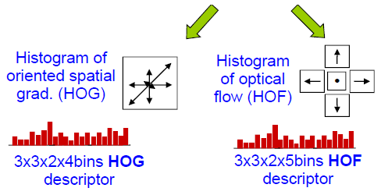
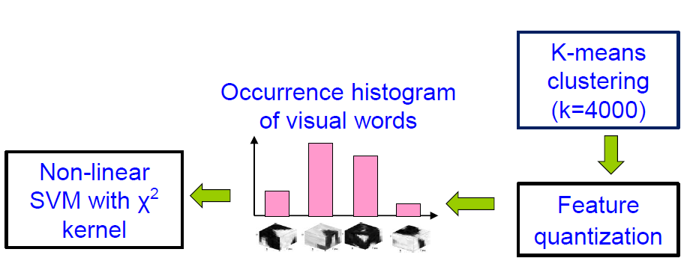
Motion Feature – Space Time Interest Point
Descriptor
Classifier (e.g., SVM)
bag-of-words representation
[Laptev 2005]
18

Slide 19
Motion Feature – Dense Trajectories
optic flow
motion boundary histogram
HoG: histogram of oriented gradients; HoF: histogram of optic flows
MBH: motion boundary histogram
19
[Wang et al. 2011]

Slide 20
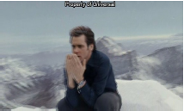
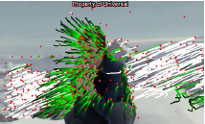
Motion Feature – Improved Dense Trajectories
Estimate camera motion to remove background optic flows
flow without camera motion compensation
flow with camera motion compensation
[Wang and Schmid 2013]
Detect human body to remove spurious trajectories
Same descriptor as that of the original dense trajectories: HoG/HoF/MBH
Use improved Fisher vector (IFV) coding [Perronnin et al. 2010]
20

Slide 21
Outline
PART I RGB based Action Recognition
Features for Action Representation
Shape and Pose
Motion
Action Recognition Framework
“Parts” + “Matching”
“Pooling” + “Classifier”
Mid-level Approaches
PART II RGB-Depth based Action Recognition
Introduction to Depth Sensor (Kinect)
RGB-Depth Features
RGB-Depth Context
Conclusions and More
21

Slide 22
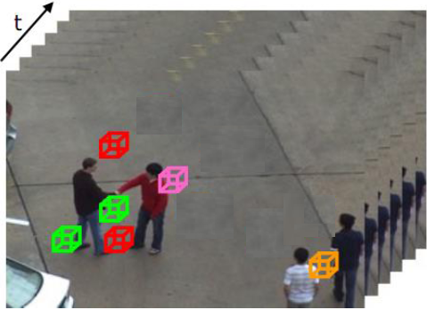
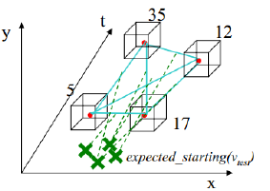
Action Recognition Framework
Relationship between “parts” forms a “graph”
An action video can be regarded as a set of localized features (“parts”)
“Match” the graph model with video observations (extracted features)
Action recognition
22

Slide 23
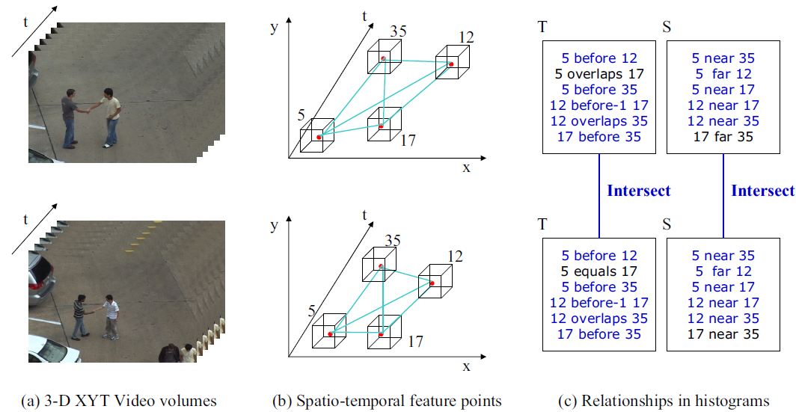
Spatio-Temporal Relationship Matching
visual word ID
xyt
Define relationships: before/after, overlap, near/far
Calculate relationship histogram to represent an action video
Match relationship histograms by histogram intersection kernel
23
[Ryoo and Aggarwal 2009]

Slide 24
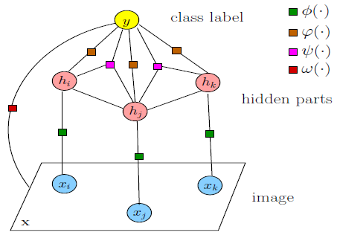
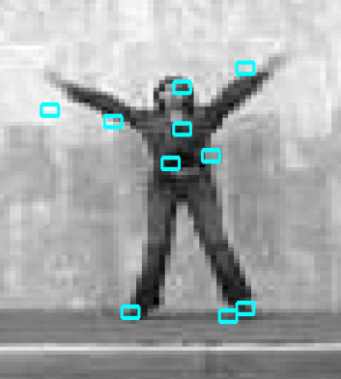
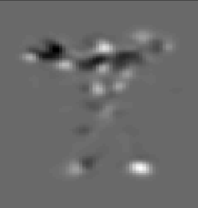
Discriminative Action Part Model
hidden parts
optic flow of whole image
image patch feature
whole image feature
optic flow of a local patch
Action is represented by the optic flow patterns of local patches + whole image
Latent variable h_{j} indicates assignment of a part model to specific image patch
A latent structural SVM problem
Solved using the method of [Felzenszwalb et al. 2010] for the part-based model
24
[Wang and Mori 2011]

Slide 25
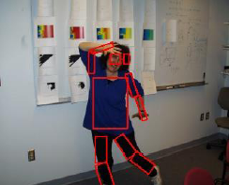
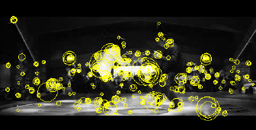
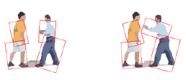
Action Recognition by “Parts” + “Matching”
Pros
Easy to explain
Works well in controlled environment
Cons
Prune to intra variation and background motion
Requires part annotation – labor intensive
Requires good model initialization for latent SVM
High computation for training a latent model
how to match local features in such cluttered background?
part annotation is required for training
25

Slide 26
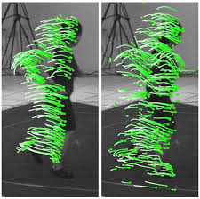
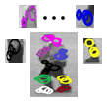
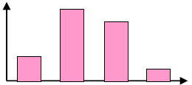
Action Recognition Framework
A typical image recognition pipeline
Feature Extraction (e.g., SIFT)
Encoding and Pooling (e.g., Bag of Words)
Discriminative Classifier (e.g., SVM)
May also apply to action recognition: “Pooling” + “Classifier”
Feature Encoding and Pooling
Feature Extraction
Classifier
26

Slide 27
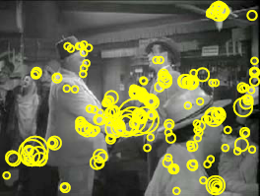
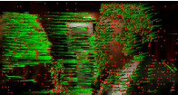
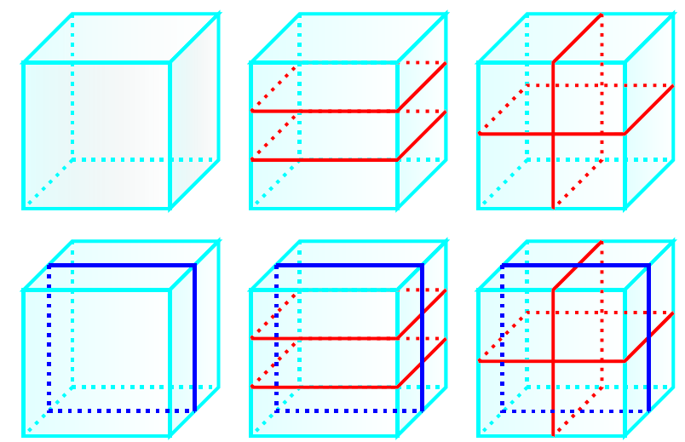
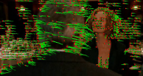
Spatio-Temporal Pyramid Pooling
[Laptev et al. 2008]
v
h
t
[Wang et al. 2011]
Partition the video volume into spatio-temporal sub-volumes
Pool local motion features (e.g., STIP, dense traj.) for each sub-volume to form bag-of-words (BoW) or improved Fisher vector (IFV) representation
Use multi-channel χ² kernel based SVM for classification
27

Slide 28
Discriminative Segments Pooling
∑
bag-of-words pooling
bag-of-words pooling
Pre-segment video; for each segment, compute BoW representation over space-time interest points
Define hidden variable to indicate discriminative segments
Latent learning:
[Niebles et al. 2010]
28
segment detection score
anchor point displacement score

Slide 29
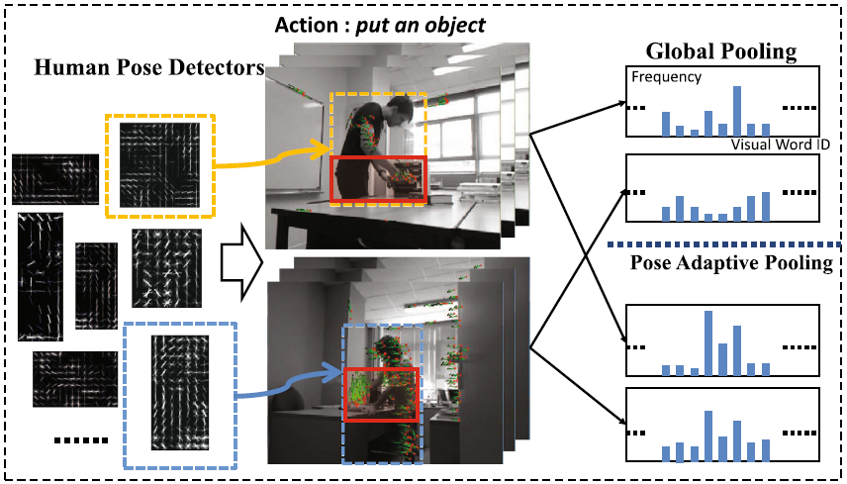
Pose Adaptive Motion Pooling
Different human poses indicate different actions
Only a small video sub-volume is responsible for the action label
May use pose as side information to select more discriminative sub-volumes for motion feature pooling
29
[Ni and Moulin 2014]

Slide 30
Pose Adaptive Motion Pooling
p: key pose type
h: which sub-volume to pool
Detect and track human into human volume
Partition each human volume into sub-volumes
Adaptively select the “best” sub-volume to pool motion features according to detected human pose type
30
[Ni and Moulin 2014]

Slide 31
Comparison of Feature Pooling Methods
Evaluation datasets: KTH (6 actions, 2391 video samples); Hollywood2 (12 actions, 1707 video samples); HMDB51 (51 actions, 6766 video samples); default train/test protocol; BoW on dense trajectory features
Evaluation metric: mean average precision (mAP)
|{relevant documents}∩{retrieved documents}|
|{relevant documents}∩{retrieved documents}|
Precision(n) =
Recall(n) =
|{retrieved documents}|
|{relevant documents}|
n: cut-off rank
rel(k): is an indicator function equalling 1 if the item at rank is a relevant document, zero otherwise
∑_{k = 1 : n}Precision(k)× rel(k)
Average Precision =
|{relevant documents}|
mAP is the mean Average Precision value over all action classes
Pooling Method | KTH | Hollywood2 | HMDB51
Spatio-temporal Pyramid | 93.9% | 57.2% | 47.8%
Human Centric | 94.1% | 58.1% | 48.5%
Pose Adaptive | 95.1% | 60.5% | 52.3%
31
[Ni and Moulin 2014]

Slide 32
Summary
Salient Features
Action Representation
Classifier
Label
learn codebook & encoding
“parts”
“matching”
“pooling”
“classifier”
General pipeline: salient feature extraction → representation → classification
Framework 1: local features → representative parts → matching parts with video observations
Framework 2: local features → pooling → classifier (e.g., SVM)
32

Slide 33
Outline
PART I RGB based Action Recognition
Features for Action Representation
Shape and Pose
Motion
Action Recognition Framework
“Parts” + “Matching”
“Pooling” + “Classifier”
Mid-level Approaches
PART II RGB-Depth based Action Recognition
Introduction to Depth Sensor (Kinect)
RGB-Depth Features
RGB-Depth Context
Conclusions and More
33

Slide 34
Action Recognition Framework
Above methods are all based on local features
“Semantic Gap”
“Shaking hands”
May use “mid-level” parts, which have more semantic meaning!
sub-volume
34
group of trajectories
body part

Slide 35
Mid-Level Approach: Trajectory Group
Group trajectories into tentative action parts by measuring similarity in motion and appearance
Learns discriminative model with latent assignment of action parts
Improved classification localization of discriminative action parts
35
[Raptis et al. 2012]

Slide 36
Mid-Level Approach: “Stacked Fisher Vector”
Randomly sample video sub-volumes
Pool within each sub-volume to a form a improved Fisher vector (IFV) [Perronnin et al. 2010]
Regard each sub-volume level IFV as a feature (after dimensionality reduction); pool the entire video volume to form a second level IFV
36
[Peng et al. 2014]

Slide 37
“Mid-Level” vs. “Low Level”
Evaluation datasets: Youtube (11 actions, 1168 video samples); HMDB51; default train/test protocol
Evaluation metric: mean average precision (mAP)
Algorithms for comparison:
1) Low level approach: (improved) dense trajectory + BoW/IFV;
2) Mid-level approach: stacked Fisher vector
Method | Youtube | HMDB51
Dense Traj. (BoW) | 85.4% | 46.6%
Improved Dense Traj. (IFV) | 90.69% | 57.2%
Stacked Fisher Vector | 93.77% | 66.79%
May indicate “mid-level feature” + “pooling” is a more discriminative method
37

Slide 38
Outline
PART I RGB based Action Recognition
Features for Action Representation
Shape and Pose
Motion
Action Recognition Framework
“Parts” + “Matching”
“Pooling” + “Classifier”
Mid-level Approaches
PART II RGB-Depth based Action Recognition
Introduction to Depth Sensor (Kinect)
RGB-Depth Features
RGB-Depth Context
Conclusions and More
38

Slide 39
Why use depth camera (Kinect) for action recognition?
3D scene structure
Easy foreground segmentation
3D motion information
Privacy
Low cost
Typically for indoor use
39
Notes:
Back to our topic. In this work, our target application is assisted living, which involves xx and xx, function’s of the proposed system is xxx

Slide 40
How Does the Kinect Depth Camera Work?
Projected
speckle pattern
Shpunt et al, PrimeSense patent application
US 2008/0106746
40
Notes:
Back to our topic. In this work, our target application is assisted living, which involves xx and xx, function’s of the proposed system is xxx

Slide 41
How Does the Kinect Depth Camera Work? (Cont’d)
41
Notes:
Back to our topic. In this work, our target application is assisted living, which involves xx and xx, function’s of the proposed system is xxx

Slide 42
Outline
PART I RGB based Action Recognition
Features for Action Representation
Shape and Pose
Motion
Action Recognition Framework
“Parts” + “Matching”
“Pooling” + “Classifier”
Mid-level Approaches
PART II RGB-Depth based Action Recognition
Introduction to Depth Sensor (Kinect)
RGB-Depth Features
RGB-Depth Context
Conclusions and More
42

Slide 43
RGB-Depth Feature: Skeleton Joints from Kinect
Can directly get real-time 3D body joints from Kinect by random forest algorithm
43
[Shotton et al. 2012]

Slide 44
RGB-Depth Feature: Skeleton Joints from Kinect
Use skeleton joints output by Kinect
Maximum-entropy Markov models
[Sung et al. 2012]
44

Slide 45
RGB-Depth Feature: Skeleton Joints from Kinect
[Wang et al. 2012]
depth map
Use skeleton joints output by Kinect
Extract motion features around each joints
Mine informative group of joints for action recognition
45

Slide 46
RGB-Depth Feature: Skeleton Joints from Kinect
Kinect skeleton estimation algorithm easily fails due to occlusion and background clutter
May use raw depth map for extracting action features
46

Slide 47
RGB-Depth Feature: Bag of 3D Points
Sample 3D points from RGB-Depth image
Calculate bag-of-3D-points representation for action recognition
47
[Li et al. 2010]

Slide 48
RGB-Depth Feature: Depth Cuboid Features
depth interest point extraction
depth cuboid similarity feature descriptor (DCSF)
Bag of depth cuboid features for action representation
48
[Xia and Aggarwal 2013]

Slide 49
RGB-Depth Feature: 3DMHIs
Depth-Induced Motion History Images (DMHIs)
Similarly to [Bobick and Davis 2001], each pixel intensity is a function of the motion recency in the depth channel at that location,
where brighter value corresponds to more recent motion
Forward/backward movement in depth channel
Forward/backward motion history images – fDMHIs, bDMHIs
[Ni et al. 2011]
49

Slide 50
RGBD-HuDaAct: Database Statistics
Activity Categories (12 + 1 neutral )
12 activities: make a phone call, mop the floor, enter the room, exit the room, go to bed, get up, eat meal, drink water, sit down, stand up, take off the jacket and put on the jacket.
1 neutral activity: the subject is either doing nothing or is engaged in some other activity not defined above
Video Data
30 subjects, 14 video capture sessions (fixed sensor configuration)
5,000,000 frames (approx. 48 hours) RGB + Depth
Manually segmented
1189 video samples, each spans about 30 – 150 seconds
Large intra-class variations
Suitable for assisted living application
Release page: www.adsc.com.sg
50
[Ni et al. 2011]
Notes:
Defined from typical human daily activities, some health-care professionals, whether the ability or inability of performing these activities serves as measurement of health status of the patient

Slide 51
RGBD-HuDaAct: Sample Images
Make a phone call
Mop the floor
Enter the room
Exit the room
Go to bed
Get up
Eat meal
Drink water
Sit down
Stand up
Take off the jacket
Put on the jacket
51
Notes:
Different ways of drinking, different ways of mop the floor

Slide 52
RGB-Depth Feature: 3DMHIs
Experimental Settings
Leave-one-subject-out on RGBD-HuDaAct dataset
SVM classifier using linear and RBF kernels, parameters set by cross-validation
Compare classification accuracies
Class confusion matrix
RGBD-HuDaAct: 12 daily action classes + 1 background action class
[Ni et al. 2011]
52
MHI
3DMHI

Slide 53
RGB-Depth Feature: DLMC-STIPs
Visual Words Vocabulary
Color images
h₁
y
Depth-layered
channel 1
#
Visual Word ID
x
STIPs
h₂
#
Depth-layered
channel 2
t-1
t
t+1
L1
L2
L3
Visual Word ID
Depth maps
h₃
y
#
Depth-layered
channel 3
Visual Word ID
x
Depth layers
z
t-1
t
t+1
Multi-channel Histogram
53
[Ni et al. 2011]

Slide 54
RGB-Depth Feature: DLMC-STIPs
Leave-one-subject-out on RGBD-HuDaAct dataset
SVM classifier using χ² distance kernel, parameters set by cross-validation
Different code book sizes
Different number of depth layers
Compare classification accuracies
[Ni et al. 2011]
54

Slide 55
Outline
PART I RGB based Action Recognition
Features for Action Representation
Shape and Pose
Motion
Action Recognition Framework
“Parts” + “Matching”
“Pooling” + “Classifier”
Mid-level Approaches
PART II RGB-Depth based Action Recognition
Introduction to Depth Sensor (Kinect)
RGB-Depth Features
RGB-Depth Context
Conclusions and More
55

Slide 56
RGB-Depth Context: Interaction Recognition
Multi-Level Depth & Image Fusion for Activity Detection
Individual Feature Extraction
Human-Human Context
Scene Context
z
y
x
scene orientation map
Use depth heuristics to remove false detection
Use depth to measure relative distance in 3D
Model 3D scene structure using depth
[Ni et al. 2013]
More Accurate Activity Detection
56

Slide 57
Fuse Different Levels Via Bayesian Network
T₁, T₂ : two tracklets of human key pose/object detections
f_{u} : single tracklet attribute
f_{d}, f_{v}, f_{o}: contextual attributes between tracklets
f_{s}: scene type attribute
T₁
T₂
f_{u}(T₁)
f_{u}(T₂)
f_{d}
f_{v}
f_{o}
f_{s}
A
A : action label
57
[Ni et al. 2013]

Slide 58
RGBD Context: Fine-grained Action Detection
Fine-grained action detection has potential application in assisted living
It is a difficult task due to frequent and subtle interaction between hand/object
breaking
cutting
baking
mixing
58

Slide 59
RGBD Context: Fine-grained Action Detection
Track hand and object jointly using RGB-Depth data
Infer the “interaction status”: what is the object being manipulated and where is the position of interaction
Use the inferred “interaction status” to retrieve relevant kitchen action sequences from the training database
Parse the action labels from the relevant training videos towards the testing video sequence
59
[Ni et al. 2014]

Slide 60
RGBD Context: Fine-grained Action Detection
Use localized contextual feature instead of global context (co-occurrence)
Detect objects, extract dense trajectories, and link them locally
Generate local (motion feature + object semantic score) pairs
Good at capturing fine-grained local interaction
60
[Zhou et al. 2014]

Slide 61
Outline
PART I RGB based Action Recognition
Features for Action Representation
Shape and Pose
Motion
Action Recognition Framework
“Parts” + “Matching”
“Pooling” + “Classifier”
Mid-level Approaches
Interaction Recognition
Global context
Local context
PART II RGB-Depth based Action Recognition
Introduction to Depth Sensor (Kinect)
RGB-Depth Features
RGB-Depth Context
Conclusions and More
61

Slide 62
Conclusions
From depth and color image sequences to multi-modal visual analytics
Quality metrics for activity recognition tasks
New features for depth images and for fusion
Machine learning framework
New applications
62

Slide 63
Next Milestone in Action Recognition?
Will CNNs take over existing action recognition methods?
-What’s a good network architecture?
-Where to get sufficient training data?
Input frames are fed into two separate streams of processing: a context stream that models low-resolution image and a fovea stream that processes high-resolution center crop. Both streams consist of alternating convolution (red), normalization (green) and pooling (blue) layers. Both streams converge to two fully connected layers (yellow).
63
[Karpathy et al. 2014]

Slide 64
Next Milestone in Action Recognition?
Method | UCF101 | HMDB51
Dense Traj. + IFV | 87.9% | 61.1%
Two Stream ConvNet | 88.0% | 59.4%
two consecutive frames
optic flow
Optical flow as input to deep network, i.e., ConvNet
Spatial stream ConvNet captures shape information
Temporal stream ConvNet captures motion information
Achieve state-of-the-art accuracy
64

Slide 65
Thank You!
65

Slide 66
Key References
A. Bobick and J. Davis, The Representation and Recognition of Action Using Temporal Template, IEEE Transactions on Pattern Analysis and Machine Intelligence, Vol. 23, No. 3, 2001, pp.257-267.
A.A. Efros, A.C. Berg, G. Mori and J. Malik, Recognizing Action at a Distance, International conference on Computer Vision, 2003.
I. Laptev, On Space-Time Interest Points, International Journal of Computer Vision, Vol. 64, No. 2/3, 2005, pp.107-123.
J.C. Niebles, C.W. Chen and L. Fei-Fei, Modeling Temporal Structure of Decomposable Motion Segments for Activity Classification, European Conference on Computer Vision, 2010, pp. 392-405.
Y. Wang and G. Mori, Hidden Part Models for Human Action Recognition: Probabilistic versus Max-Margin, IEEE Transactions on Pattern Analysis and Machine Intelligence, vol.33, no.7, pp1310-1323, 2011.
H. Wang,A. Klaser, C. Schmid and C. Liu, Action Recognition by Dense Trajectories, IEEE Conference on Computer Vision and Pattern Recognition, 2011, pp. 3169-3176.
66

Slide 67
Additional References
L. Gorelick, M. Blank, E. Shechtman , M. Irani and R. Basri, Actions as Space-Time Shapes, Transactions on Pattern Analysis and Machine Intelligence, Vol. 29, No. 12, 2007, pp. 2247-2253.
I. Laptev, M. Marszałek, C. Schmid and B. Rozenfeld, Learning Realistic Human Actions from Movies, IEEE Conference on Computer Vision and Pattern Recognition, 2008.
H. Wang and C. Schmid, Action Recognition with Improved Trajectories, IEEE Conference on Computer Vision and Pattern Recognition, 2013.
M. S. Ryoo and J. K. Aggarwal, Spatio-Temporal Relationship Match: Video Structure Comparison for Recognition of Complex Human Activities, International Conference on Computer Vision, 2009.
B. Ni and P. Moulin, Pose Adaptive Motion Feature Pooling for Human Action Analysis, International Journal of Computer Vision, 2014.
B. Ni, G. Wang and P. Moulin, RGBD-HuDaAct: A Color-Depth Video Database for Human Daily Activity Recognition, ICCV workshops, pp. 1147–1153, 2011.
A. Gupta and L. Davis, Objects in action: An approach for combining action understanding and object perception, IEEE Conference on Computer Vision and Pattern Recognition, 2007.
L. Xia and J.K. Aggarwal, Spatio-Temporal Depth Cuboid Similarity Feature for Activity Recognition Using Depth Camera, IEEE Conference on Computer Vision and Pattern Recognition, 2013.
67

Slide 68
Additional References
H. Kjellstrom, J. Romero, D. Martinez and D. Kragic. Simultaneous Visual Recognition of Manipulation Actions and Manipulated Objects. European Conference on Computer Vision, pp. 336–349, 2008.
R. Messing, C. Pal and H. Kautz, Activity Recognition Using the Velocity Histories of Tracked Keypoints, IEEE Conference on Computer Vision and Pattern Recognition, pp. 104–111, 2009.
B. Yao, A. Khosla and L. Fei-fei. Classifying Actions and Measuring Action Similarity by Modeling the Mutual Context of Objects and Human Poses. International Conference on Machine Learning, 2011.
A. Patron-Perez, M. Marszalek, A. Zisserman and I. Reid, High Five: Recognising Human Interactions in TV Shows, British Machine Vision Conference, 2010.
P. Felzenszwalb, R. Girshick, D. McAllester and D. Ramanan, Object Detection with Discriminatively Trained Part Based Models, IEEE Transactions on Pattern Analysis and Machine Intelligence, Vol. 32, No. 9, Sep. 2010.
68

Slide 69
Additional References
M. Raptis and L. Sigal, Poselet Key-Framing: A Model for Human Activity Recognition, International conference on computer vision and pattern recognition, pp. 2650–2657, 2013.
L. D. Bourdev and J. Malik, Poselets: Body Part Detectors Trained Using 3D Human Pose Annotations. International Conference on Computer Vision, 2009.
X.J. Peng, C.Q. Zou, Y. Qiao, and Q. Peng, Action Recognition with Stacked Fisher Vectors, European Conference on Computer Vision, 2014.
F. Perronnin, J. S′anchez and T. Mensink, Improving the Fisher Kernel for Large-Scale
Image Classification. European Conference on Computer Vision, pp.143–156, 2010.
W. Li, Z. Zhang and Z. Liu. Action Recognition Based on a Bag of 3D Points, CVPR workshop, 2010.
H.S. Koppula, R. Gupta and A. Saxena, Learning Human Activities and Object Affordances from RGB-D Videos, arXiv:1210.1207, 2012.
J. Wang, Z. Liu, Y. Wu and J. Yuan, Mining Actionlet Ensemble for Action Recognition with Depth Cameras. IEEE Conference on Computer Vision and Pattern Recognition, pp. 1290–1297, 2012.
69

Slide 70
Additional References
J. Liu, J. Luo and M. Shah. Recognizing Realistic Actions from Videos in the Wild. IEEE Conference on Computer Vision and Pattern Recognition, 2009 (Youtube).
C. Schuldt, I. Laptev and B. Caputo. Recognizing Human Actions: A Local SVM Approach. International Conference on Pattern Recognition, 2004 (KTH).
H. Kuehne, H. Jhuang, E. Garrote, T. Poggio and T. Serre, HMDB: A large video database for human motion recognition, International Conference on Computer Vision, 2011 (HMDB51).
J. Wang, J. Yang, K. Yu, F. Lv, T. Huang and Y. Gong, Locality-Constrained
Linear Coding for Image Classification, IEEE Conference on Computer Vision and Pattern Recognition, pp. 3360-3367, 2010.
B. Ni, G. Wang and P. Moulin, RGBD-HuDaAct: A Color-Depth Video Database for Human Daily Activity Recognition, Consumer Depth Cameras for Computer Vision, pp.193-208, 2011.
B. Ni, C.D. Nguyen, RGBD-Camera Based Get-up Event Detection for Hospital Fall Prevention, International Conference on Acoustic, Speech and Signal Processing, 2012.
L. Xia, C.C. Chen and J.K. Aggarwal, View Invariant Human Action Recognition Using Histograms of 3D Joints, CVPR workshop, 2012.
70

Slide 71
Additional References
N. Dalal and B. Triggs, Histograms of Oriented Gradients for Human Detection, IEEE Conference on Computer Vision and Pattern Recognition, 2005.
B. Ni, Y. Pei and P. Moulin, Multi-level Depth and Image Fusion for Human Activity Detection, IEEE Transactions on Cybernetics, Vol. 43, No. 5, pp. 1383-1394, 2013.
B. Ni, V. Ramkrishnan and P. Moulin, Multiple Granularity Analysis for Fine-Grained Action Detection, IEEE Conference on Computer Vision and Pattern Recognition, 2014.
K. Tang, L. Fei-Fei and D. Koller, Learning Latent Temporal Structure for Complex Event Detection, IEEE Conference on Computer Vision and Pattern Recognition, 2012.
S. Sadanand and J. J. Corso. Action bank: A High-level Representation of Activity in Video, IEEE Conference on Computer Vision and Pattern Recognition, 2012.
J. Yamato, J. Ohya and K. Ishii, Recognizing Human Action in Time-Sequential Images Using Hidden Markov Model, IEEE Conference on Computer Vision and Pattern Recognition, 1992.
L. Wang and D. Suter, Recognizing Human Activities from Silhouettes: Motion Subspace and Factorial Discriminative Graphical Model, IEEE Conference on Computer Vision and Pattern Recognition, 2007.
71

Slide 72
Additional References
M.J. Black, Y. Yacoob, A.D. Jepson and D.J. Fleet, Learning Parameterized Models of Image Motion, IEEE Conference on Computer Vision and Pattern Recognition, 1997.
K. Tang, L. Fei-Fei and D. Koller, Learning Latent Temporal Structure for Complex Event Detection, IEEE Conference on Computer Vision and Pattern Recognition, 2012.
M. Raptis, I. Kokkinos and S. Soatto, Discovering Discriminative Action Parts from Mid-Level Video Representations, IEEE Conference on Computer Vision and Pattern Recognition, 2012.
A. Karpathy, S. Shetty, G. Toderici, R. Sukthankar, T. Leung and L. Fei-Fei, Large-scale Video Classification using Convolutional Neural Networks, IEEE Conference on Computer Vision and Pattern Recognition, 2014.
C. Lu, J. Jia and C.K. Tang, Range-Sample Depth Feature for Action Recognition, European Conference on Computer Vision, 2014.
J. Sung, C. Ponce, B. Selman and A. Saxena, Unstructured Human Activity Detection from RGBD Images, International Conference on Robotics and Automation, 2012.
J. Shotton, A. Fitzgibbon, M. Cook, T. Sharp, M. Finocchio, R. Moore, A. Kipman, and A. Blake, Real-Time Human Pose Recognition in Parts from a Single Depth Image, IEEE Conference on Computer Vision and Pattern Recognition, 2012.
72

